Slide 1


DEEP LEARNING ALGORITHMS
(CNN,RNN&LSTM)
SNEHA R
INTERNSHIP-JUNE 2023

Slide 2
NEURAL NETWORK
Set of algorithms
inputs large set of data, process the data
draws out the patterns and outputs what it is
Artificial Neural networks(ANN’s)
Artificially mimic the functioning of Neural network

Slide 3
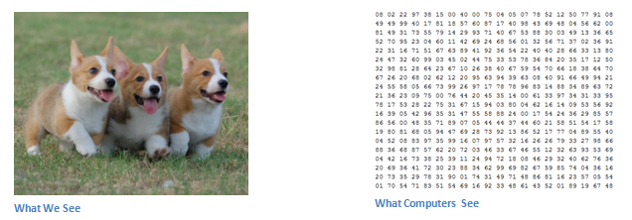
CONVOLUTIONAL NEURAL NETWORK
process images as matrices of numbers
assign importance to its various aspects/features
each input image will pass it through a series of layers
Images recognition & image classifications

Slide 4
WHY CONVOLUTIONAL NEURAL NETWORKS?
Neural Networks are good at Image Recognition
If the image is of Large pixels ➔ no. of parameters increase
Slow and consumes a lot of computational power
PHASES IN CNN
Convolutional Neural Networks have 2 main phases:
Feature learning
Classification

Slide 5
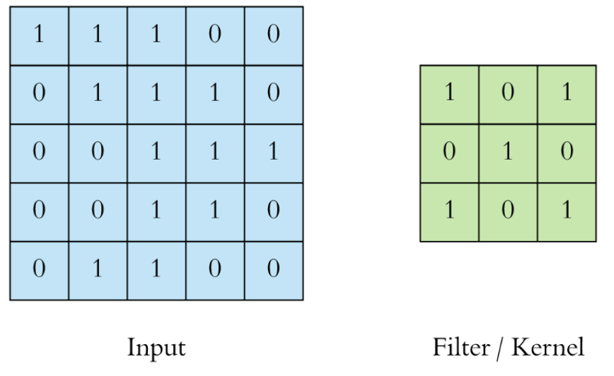
DIFFERENT LAYERS IN CNN
Convolution Layer
Core building block of CNN
Extract features such as edges, colours, corners from the input
Filter/kernel ➔ set of learnable parameters
If the image is RGB then the filter will have height x width x 3 dimension

Slide 6
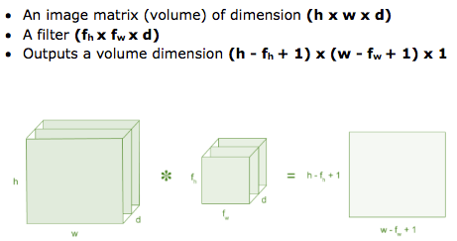
Performs a dot product between filter matrix and the restricted portion of the image
At the end of the convolution process, we have a featured matrix
Has lesser parameters
More clear features than the actual one

Slide 7
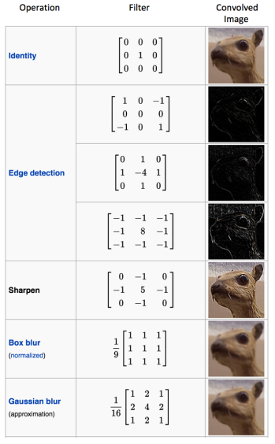
Common filters used :

Slide 8
II.Activation Layer
Activation function
Add non-linearity to the network
ReLU-Rectified Linear Unit
Allow network to learn complex representations
Volume remains unchanged

Slide 9
III.Pooling layer
To reduce the number of parameters
Also called subsampling or downsampling
Solely to decrease the computational power
Extracts the dominant features from a restricted amount of neighborhood

Slide 10
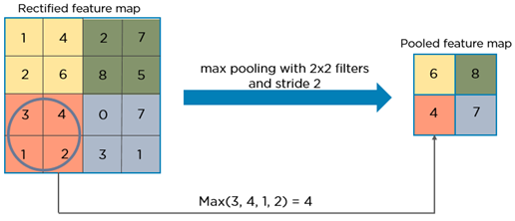
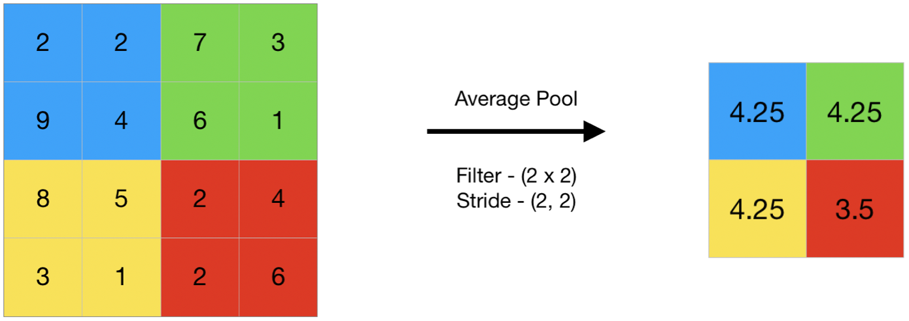
Types of pooling techniques:
AVERAGE-pooling: Take average of all the values of pooling region
MAX- pooling : Take the maximum amongst all the values lying inside the pooling region
SUM - pooling: Sum of all elements in the feature map

Slide 11
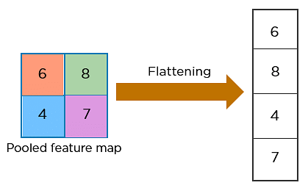
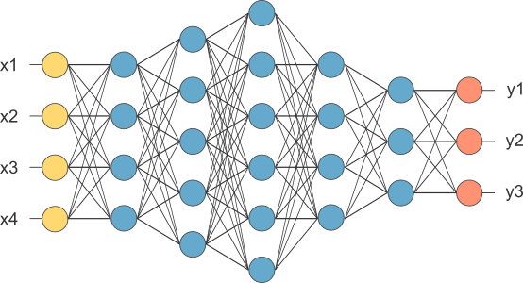
IV.Fully connected layer:
Does the classification process
Flattened the matrix into vector - FLATTENING
Feed it into a fully connected layer

Slide 12
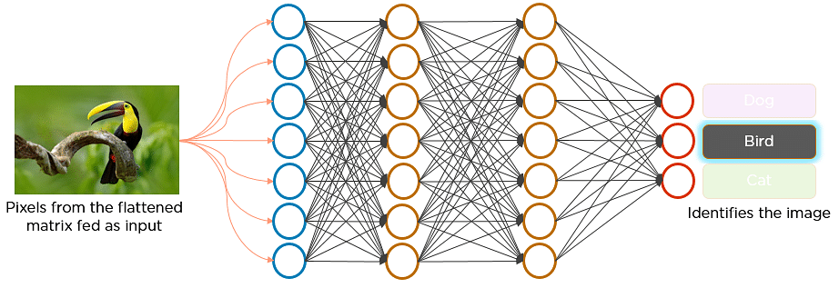
Fully connected layer

Slide 13
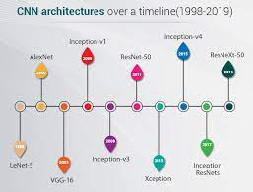
VARIOUS CNN ARCHITECTURES:

Slide 14
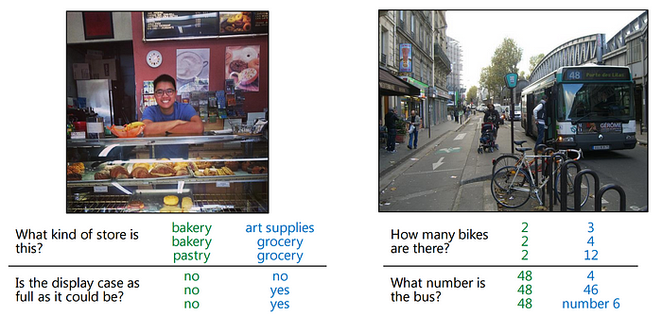
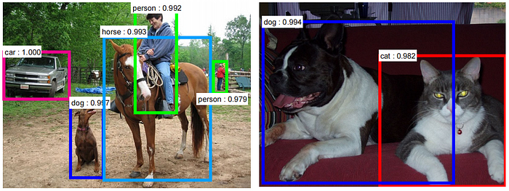
APPLICATIONS:
Question and answering:
Object detection:

Slide 15
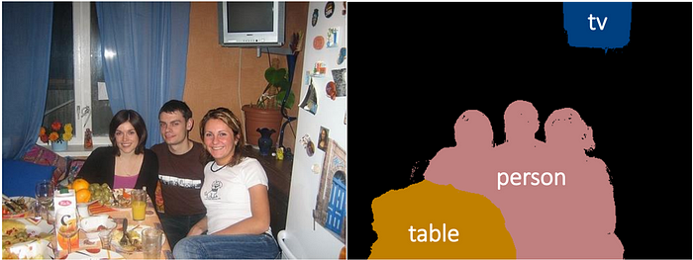
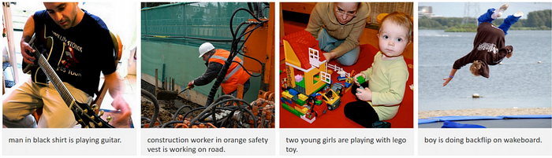
Semantic segmentation:
Image caption:

Slide 16
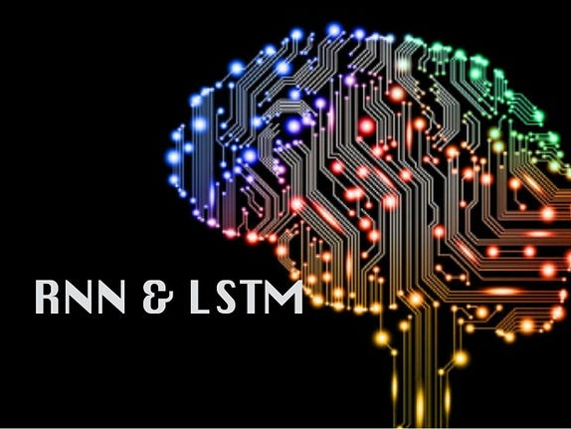

Slide 17
RECURRENT NEURAL NETWORK
Recurrent in nature
Has memory capabilities
Effectively deals with sequential data
Has two inputs-the present and the recent past
Apples Siri and Googles Voice Search

Slide 18
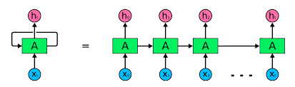
REPRESENTATION OF RNN

Slide 19
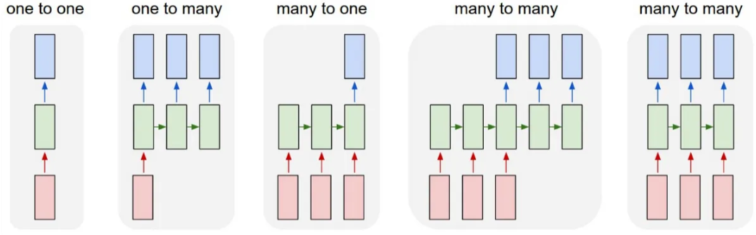
TYPES OF RNN ARCHITECTURE
IMAGE CLASSIFICATION IMAGE CAPTIONING SENTIMENT ANALYSIS LANGUAGE TRANSLATION

Slide 20
LIMITATIONS OF RNN:
Computationally Expensive => for long sequences of data
Limited Memory => in handling long-term dependencies in data
Overfitting => with small datasets
Unstable Training => difficult to train
Sensitive to the initial values of the parameters

Slide 21
LONG SHORT TERM MEMORY NETWORKS
Variant of RNN
Allows to regulate how to learn or forget efficiently
Gates regulate the flow of information.
Cell State encodes the information of the inputs up to that step
Hidden state is an output of the LSTM cell,used for Prediction

Slide 22
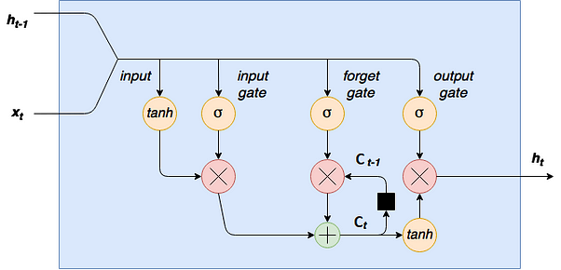
LSTM ARCHITECTURE

Slide 23
GATES IN LSTM NETWORK
Input gate:
creates an array of information using activation function tanh (generates values between -1 & 1)
sigmoid function - act as filter , regulate information to be added to cell
Output gate :
creates a vector of values using tanh function
sigmoid function and which values should be shown as output
Forget gate :
decide which information to forget
optimization of performance
0 -remove that information
1 -information has to be remembered

Slide 24
APPLICATIONS OF RNN AND LSTM
Time series prediction
Speech recognition
Handwriting recognition
Human action recognition
Sign Language Translation
Rhythm learning
Music composition
Grammar learning

Slide 25
THANK YOU

